Slide 1
3
Managers and Management

Slide 2
Learning Outcomes
Who managers are and where they work
Define management
What managers do
Skills required for manager
Describe the factors that are reshaping and redefining management

Slide 3

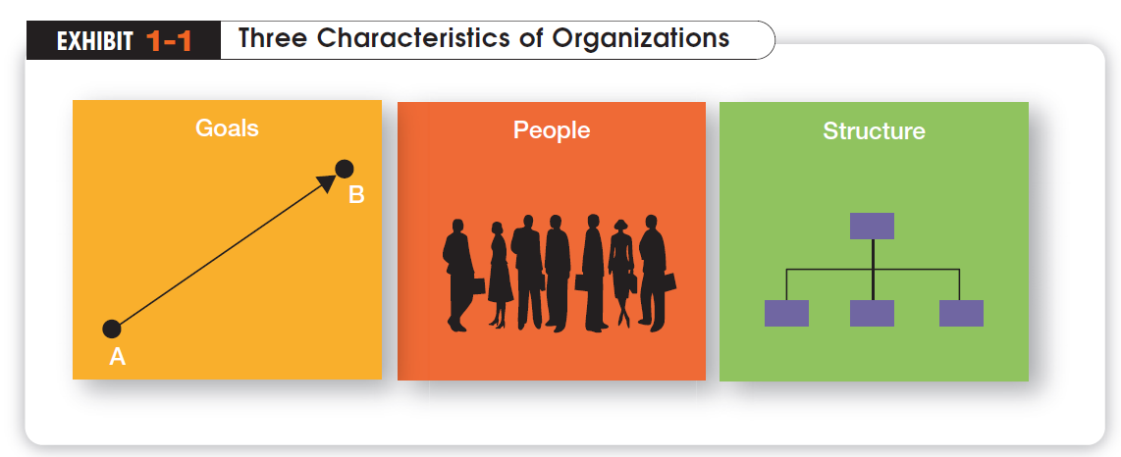
Who Are Managers? Where Do They Work?
Organisation
A deliberate arrangement of people brought together to accomplish a specific purpose.
Common Characteristics of Organisations
Distinct purpose
People working together
A deliberate systematic structure
Notes:
Managers work in organisations. We define organisations as A deliberate arrangement of people brought together to accomplish some are deliberate arrangements of people to accomplish a specific purpose. Examples include your college or university, the United Way, your neighborhood convenience store, the Dallas Cowboys football team, fraternities and sororities, the Cleveland Clinic and Nokia.

Slide 4


How Are Managers Different from Nonmanagerial Employees?
Nonmanagerial Employees
People who work directly on a job or task and have no responsibility for overseeing the work of others.
Examples, associates, team members
Managers
Individuals in organisations who direct the activities of others.
Notes:
For simplicities sake, we can divide organisation members into two categories: nonmanagerial employees and managers. Nonmanagerial employees do not oversee the work of others. Managers direct and oversee the activity of the people in the organisation.

Slide 5
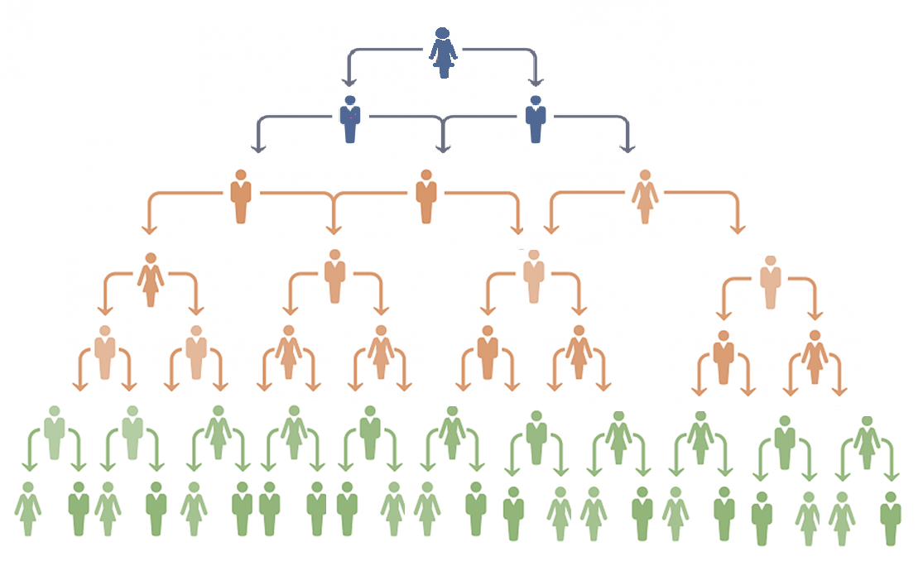
Management Levels
Top Managers / Strategic
Responsible for making decisions about the direction of the organisation.
Examples; President, Chief Executive Officer, Vice-President
Middle Managers / Tactical
Manage the activities of other managers.
Examples; District Manager, Division Manager
First-line Managers / Operational
Responsible for directing nonmanagerial employees
Examples; Supervisor, Team Leader

Slide 6
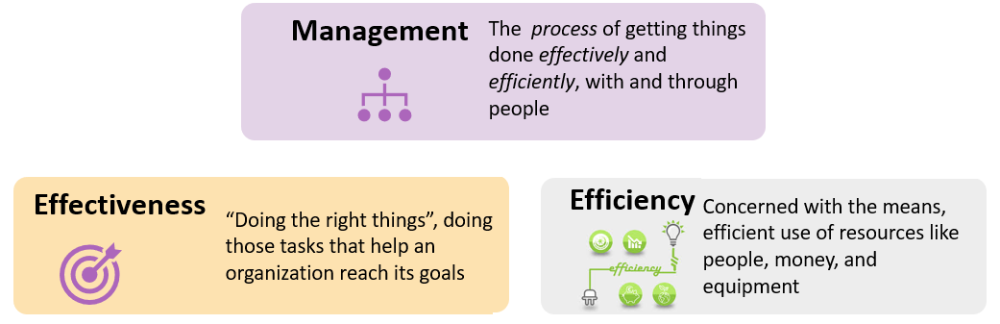
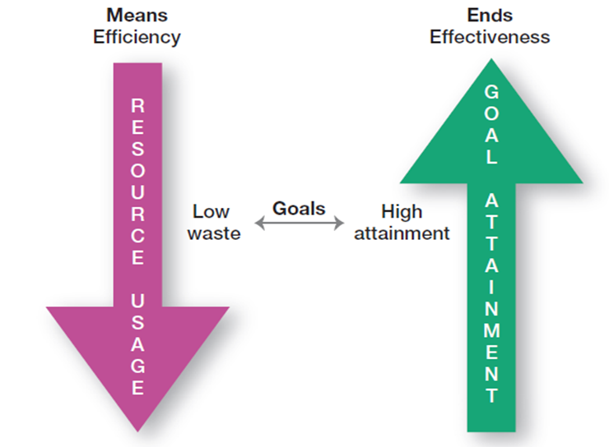
What Is Management?
Notes:
Management is a process of getting things done, effectively and efficiently, with through people. A process is a set of ongoing and interrelated activities. In our definition it refers to the primary activities or functions managers perform.

Slide 7
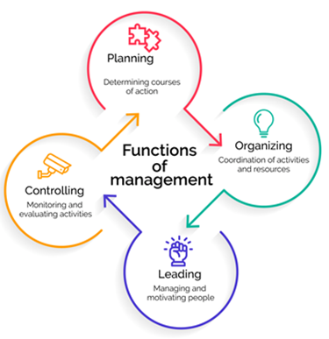
Four Management Functions
What Do Managers Do?
French industrialist Henri Fayol, describes all managers perform certain activities or functions that can be classified in four management functions
Planning
Defining the organisational purpose and ways to achieve it
Organizing
Arranging and structuring work to accomplish organisational goals
Leading
Directing the work activities of others
Controlling
Monitoring, comparing, and correcting work performance
Notes:
Planning includes defining goals, establishing strategy, and developing plans to coordinate activities. Organizing includes determining what tasks need to be done and by whom. Leading includes motivating, directing the activities of others, and resolving conflicts. Controlling involves monitoring, comparing, and correcting work performance.

Slide 8
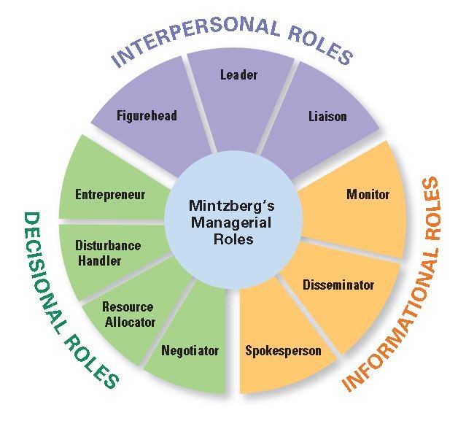
What Roles Do Managers Play?
Henry Mintzberg observed that a manager’s job can be described by ten roles performed by managers in three general categories
Notes:
In the 1960s, Henry Mintzberg did an empirical study of chief executives and discovered that managers were engaged in a number of varied, un-patterned, and short-duration activities. He defined management by categorizing what managers do based on the managerial roles they perform at work.

Slide 9
What Skills Do Managers Need?
Robert Katz and others describe four critical skills in managing
Conceptual Skills
Used to analyze complex situations
Interpersonal Skills
Used to communicate, motivate, mentor and delegate
Technical Skills
Based on specialized knowledge required for work
Political Skills
Used to build a power base and establish connections
Notes:
Another way to describing what managers do is by looking at the skills they need in managing. Managers must possess four critical skills in managing. Conceptual skills, Interpersonal Skills, Technical Skills and Political Skills.

Slide 10

Is The Manager’s Job Universal?
The previous discussions describe management as a generic activity.
In reality, a manager’s job varies with along several dimensions
Level within the Organisation
Top level managers do more planning than supervisors
Profit vs. Nonprofit
Management performance is measured on different objectives
Size of the Organisation
Small businesses require an emphasis in the management role of spokesperson
Notes:
While the importance of managerial roles varies depending on a manager’s position within an organisation, the differences are of degree and emphasis, not of function. As managers move up the organisation, for example, they spend less time supervising and more time planning.
All managers, however, make decisions and plan, lead, organize, and control. But the amount of time they give to each activity is not necessarily constant. In addition, the content of the managerial activities changes with the manager’s level.
When measuring managerial performance in business, profit (the bottom line) is an unambiguous criterion. Even though not-for-profit organisations need money to survive, however, their managers do not live and die to maximize profits.
Given this difference, managers working in profit and not-for-profit organisations must perform similar functions: planning, organizing, leading, and controlling.

Slide 11
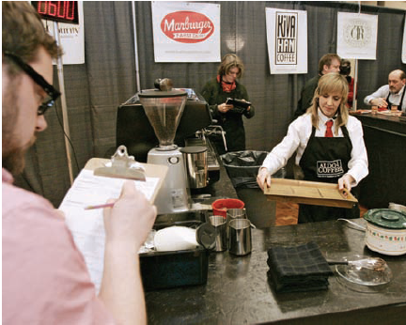
Is the Manager’s Job Universal? (cont’d)
Organisational and national culture
These concepts work best in one culture need not work in a different cultures.
Nature of the industry and situation
The nature of industry and current business situation calls for difference in nature on managing.
Are there differences between male and female managers?

Slide 12
Questions ?

Slide 13
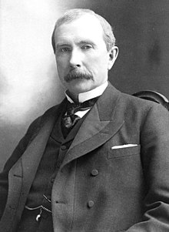
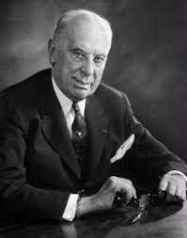
Management Advocates
John Rockefeller - Standard Oil - "The growth of a large business is merely a survival of the fittest“ – Horizontal Integration
Alfred Sloan – General Motors – Brand Architecture, Planned obsolescence
Robert McNamara – Ford – Adopted computers to construct models to find the most efficient, rational means of production, which led to much rationalisation. Advocated Scientific Management Style.
Harold Geneen – ITT* - Built International Conglomerate of unrelated diversification
Reginald H Jones and John Welch– GE - Redesigning organisational model towards Revenue, relationship-oriented leadership style with Focus, consistency and follow-up
William Gates - Microsoft
* Founded as International Telephone & Telegraph. Now called just ITT Inc

Slide 14
The Economic Crisis - 2008
Began with turmoil in mortgage markets
Spread to businesses when broader credit markets collapsed
Called the worst since the Great Depression
Foreclosures, financial recession, a huge public debt, and widespread social problems from job losses signal that the U.S. and global economic environments have changed and are continuing to change
Notes:
This economic crisis, which began with turmoil in mortgage markets and spread to businesses when broader credit markets collapsed, has been called the worst since the Great Depression. With foreclosures, financial recession, a huge public debt, and widespread social problems from job losses, it’s clear that the U.S. and global economic environments have changed and are continuing to change. For instance, the International Monetary Fund forecasted that the global economy would likely contract in 2009 for the first time since World War II and that the recovery would take longer than expected

Slide 15
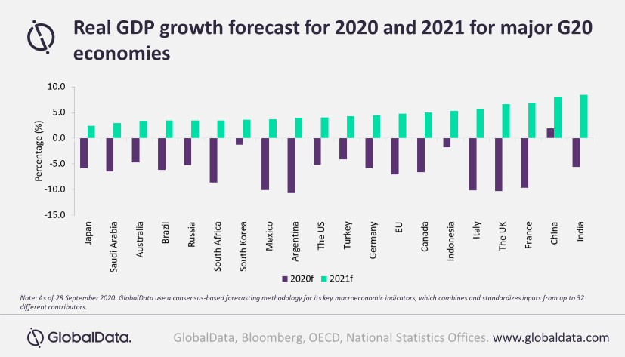
The Economic Crisis – 2020-2021
Began with uncertainties over Covid-19 impact on markets
Many businesses entered lockdown creating panic and chain reaction
Many large industries turned to Government for rescue package
Further foreclosures, financial recession, a huge public debt, and widespread social problems from job losses
Many changes to global economic environments have changed creating lasting impact

Slide 16
What Does the Workforce Look Like Today?
Those born before 1946 - 6 percent of the workforce
Baby boomers , born between 1946 and 1964 - 41.5 percent of the workforce
Generation X, born 1965 to 1977 - 29 percent of the workforce
Gen Y , born 1978 to 1994 - 24 percent of the workforce.
Gen Z is the newest generation to be named and were born between 1995 and 2015 – the future work force from 2025.
Notes:
Much of the change in the U.S. workforce over the last 50 years can be attributed to federal legislation enacted in the 1960s that prohibited employment discrimination. With these laws, avenues opened up for minority and female job applicants. These two groups dramatically changed the workplace in the latter half of the twentieth century. Women, in particular, have changed the composition of the workforce as they now hold some 49.1 percent of jobs

Slide 17
What Will the “New” Normal Be Like?
The New Normal
“Capitalism will be different” Timothy Geithner, the former U.S. Secretary of the Treasury
Increased role of government, especially in financial markets
Government spending is now at levels not seen since World War Two
Public concerns about the growing budget deficit and increased government intervention in the economy.
Notes:
Experts believe that once the U.S. economy emerges from recession things won’t be the way they were—that there will be a “new” normal. As Timothy Geithner, the former U.S. Secretary of the Treasury, said, “Capitalism will be different.”10 How managers manage and the way
businesses operate will not be as they’ve always been. The biggest change is likely to be in the role of government, especially in financial markets and in consumer protection

Slide 18
How Are Managers Adapting to a Changing Workforce?
Family-Friendly Benefits
Benefits that provide a wide range of scheduling options that allow employees more flexibility at work, accommodating their needs for work/life balance
Contingent Workforce
Few core workers and rest are Part-time, temporary, and contract workers who are available for hire on an as-needed basis
Notes:
Today’s progressive workplaces must accommodate the varied needs of a diverse workforce. In response, many organisations are offering family-friendly benefits, benefits that provide a wide range of scheduling options that allow employees more flexibility at work, accommodating their need for work/life balance.

Slide 19
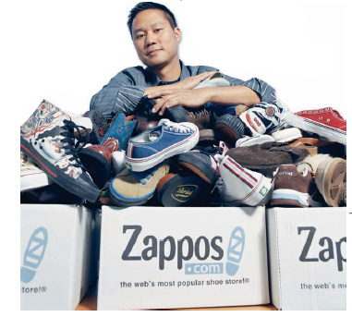
Why Is Innovation Important to the Manager’s Job?
“Nothing is riskier than not innovating”
Innovation isn’t just important for high technology companies but essential in all types of organisations

Slide 20

Why Are Customers Important to the Manager’s Job?
Without customers most organisations would cease to exist
Today we’re discovering that employee attitudes and behaviors play a big part in customer satisfaction
Managers must create a customer responsive where employees are friendly, knowledgeable, responsive to customer needs

Slide 21
The End

